Slide 1
RAINBOW: A Global, Phase III, Randomized, Double-Blind Study of Ramucirumab Plus Paclitaxel Versus Placebo Plus Paclitaxel in the Treatment of Advanced Gastric and Gastroesophageal Junction Adenocarcinoma Following Disease Progression on First-Line Platinum- and Fluoropyrimidine-Containing Combination Therapy: An Age Group Analysis
Abstract 11
Muro K, Bodoky G, Cesas A, Chao Y, Clingan P, Hironaka S, Komatsu Y, Kurteva GP, Lipatov ON, Nishina T, Oh SC, Ohtsu A, Shimada Y, Sugimoto N, Van Cutsem E, Carlesi R, Chandrawansa K, Wilke H
Notes:
Ladies and gentleman, Chairman I would like to thank the Organising Committee giving me fthis opportunity of presenting to you data from the Myeloma UK Clinical Trials Network, randomised, phase 2 study of Bendamustine in relapsed refractory myeloma.

Slide 2

Background
Ramucirumab (RAM) is a human immunoglobulin GI (IgG1) monoclonal antibody vascular endothelial growth factor (VEGF) receptor 2 antagonist recently approved by the US FDA for use as a single agent or in combination with paclitaxel in second-line metastatic gastric or gastroesophageal junction (GEJ) adenocarcinoma
In the pivotal RAINBOW trial,¹ 665 patients with gastric/GEJ adenocarcinoma were randomized to receive paclitaxel +/- ramucirumab as second-line treatment after disease progression on platinum and fluoropyrimidine- based chemotherapy. Ramucirumab added to paclicaxel significantly improved overall survival, progression-free survival, and objective response rate in the overall population
Median OS: 9.6 months vs 7.4 months (HR = 0.807; P = .0169)
Median PFS: 4.4 months vs 2.9 months (HR = 0.635; P<.0001)
ORR: 27.9% vs 16.1% (odds ratio = 2.14; P = .0001)
Here we report the efficacy and safety results by age subgroup (<65 vs ≥65 years) in the RAINBOW trial
1. Wilke H, et al. Lancet Oncol. 2014;15(11):1224-1235.
Muro K, et al. J Clin Oncol. 2015;33 (suppl 3): Abstract 11.
Notes:
Further references in support of bullet 4 and reference 5:
1. Cascinu S, Graziano F, Cardarelli N, Marcellini M, Giordani P, Menichetti ET, et al. Phase II study of paclitaxel in pretreated advanced gastric cancer. Anticancer Drugs. 1998;9(4):307-310.
2. Ohtsu A, Boku N, Tamura F, Muro K, Shimada Y, Saigenji K, et al. An early phase II study of a 3-hour infusion of paclitaxel for advanced gastric cancer. Am J Clin Oncol. 1998;21(4):416-419.
3. Yamada Y, Shirao K, Ohtsu A, Boku N, Hyodo I, Saitoh H, et al. Phase II trial of paclitaxel by three-hour infusion for advanced gastric cancer with short premedication for prophylaxis against paclitaxel-associated hypersensitivity reactions. Ann Oncol. 2001;12(8):1133-1137.
4. Yamaguchi K, Tada M, Horikoshi N, Otani T, Takiuchi H, Saitoh S, et al. Phase II study of paclitaxel with 3-h infusion in patients with advanced gastric cancer. Gastric Cancer. 2002;5(2):90-95.
5. Hironaka S, Zenda S, Boku N, Fukutomi A, Yoshino T, Onozawa Y. Weekly paclitaxel as second-line chemotherapy for advanced or recurrent gastric cancer. Gastric Cancer. 2006;9(1):14-18.
6. Kodera Y, Ito S, Mochizuki Y, Fujitake S, Koshikawa K, Kanyama Y, et al. A phase II study of weekly paclitaxel as second-line chemotherapy for advanced gastric Cancer (CCOG0302 study). Anticancer Res. 2007;27(4C):2667-2671.

Slide 3
RAINBOW: Study Design
1:1
Ramucirumab 8 mg/kg day 1&15
+ Paclitaxel 80 mg/m² day 1,8 &15
of a 28-day cycle
N = 330
R
A
N
D
O
M
I
Z
E
Treat until disease progression or intolerable toxicity
Survival and safety follow-up
S
C
R
E
EN
Placebo(PBO) day 1&15
+ Paclitaxel 80 mg/m² day 1,8 &15
N = 335
Important inclusion criteria:
- Metastatic or loc. adv. unresectable gastric or GEJ* adenocarcinoma
- Progression after first-line platinum/fluoropyrimidine-based chemotherapy
Stratification factors:
- Geographic region,
- Measurable vs nonmeasurable disease,
- Time to progression on first-line therapy (<6 months vs ≥6 months)
*Gastric and GEJ will be summarized under the term GC
Wilke H, et al. J Clin Oncol. 2014;32(suppl 3): Abstract LBA7.
Muro K, et al. J Clin Oncol. 2015;33 (suppl 3): Abstract 11.

Slide 4
RAINBOW: Patient Eligibility
Key Inclusion Criteria
Histologically or cytologically confirmed gastric / GEJ adenocarcinoma
Disease progression during first-line therapy or ≤4 months after last dose of first-line therapy with any platinum/fluoropyrimidine doublet with or without an anthracycline
ECOG PS score 0-1
Adequate hepatic, hematologic, coagulation, and renal function
Key Exclusion Criteria
No prior treatment with an antiangiogenic agents
GI perforation and/or fistulae within 6 months prior to randomization
Significant GI bleeding within 3 months prior
Venous thromboembolic event within 3 months, or arterial thromboembolic event within 6 months prior to randomization
ECOG PS, Eastern Cooperative Oncology Group performance statuS
Wilke H, et al. J Clin Oncol. 2014;32(suppl 3): Abstract LBA7.
Muro K, et al. J Clin Oncol. 2015;33 (suppl 3): Abstract 11.

Slide 5

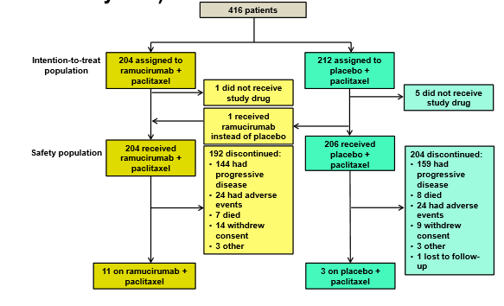
Patient Disposition by Age Group Patients <65 Years
Muro K, et al. J Clin Oncol. 2015;33 (suppl 3): Abstract 11.

Slide 6
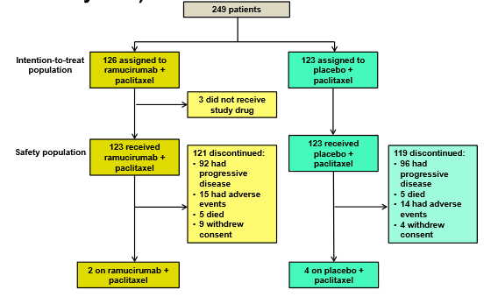
Patient Disposition by Age Group Patients ≥65 Years
Muro K, et al. J Clin Oncol. 2015;33 (suppl 3): Abstract 11.

Slide 7
Baseline Patient Characteristics (1)
 | Age <65 Years |  | Age ≥65 Years
 | RAM (N = 204) | PBO (N = 212) | RAM (N = 126) | PBO (N = 123)
Mean Age, years (SD) | 54 (8.8) | 53 (8.8) | 70 (4.0) | 71 (3.8)
Male, n (%) | 141 (69) | 144 (68) | 88 (70) | 99 (80)
Race, n (%)
Caucasian | 127 (62) | 127 (60) | 81 (64) | 72 (58)
Asian | 68 (33) | 73 (34) | 42 (33) | 48 (39)
Black | 4 (2.0) | 4 (1.9) | 2 (1.6) | 2 (1.6)
Other | 5 (2.5) | 8 (3.8) | 1 (0.8) | 1 (0.8)
ECOG PS, n (%)
0 | 73 (36) | 95 (45) | 44 (35) | 49 (40)
1 | 131 (64) | 117 (55) | 82 (65) | 74 (60)
Muro K, et al. J Clin Oncol. 2015;33 (suppl 3): Abstract 11.

Slide 8
Baseline Patient Characteristics (2)
 | Age <65 years |  | Age ≥65 years
 | RAM (N = 204) | PBO (N = 212) | RAM (N = 126) | PBO (N = 123)
Measureable disease, n (%) | 153 (75) | 162 (76) | 103 (82) | 103 (84)
Location of primary tumor, n (%)
Gastric | 157 (77) | 168 (79) | 107 (85) | 96 (78)
Gastroesophageal junction | 47 (23) | 44 (21) | 19 (15) | 27 (22)
Histological subtype, n (%)
Intestinal | 80 (39) | 77 (36) | 65 (52) | 58 (47)
Diffuse | 80 (39) | 89 (42) | 35 (28) | 44 (36)
Mixed/unknown | 44 (22) | 46 (22) | 26 (21) | 21 (17)
0 | 73 (36) | 95 (45) | 44 (35) | 49 (40)
1 | 131 (64) | 117 (55) | 82 (65) | 74 (60)
Metastases >2 sites | 73 (36) | 62 (29) | 48 (38) | 41 (33)
TTP on first-line <6 months, n (%) | 148 (72) | 132 (62) | 60 (48) | 68 (55)
Muro K, et al. J Clin Oncol. 2015;33 (suppl 3): Abstract 11.

Slide 9
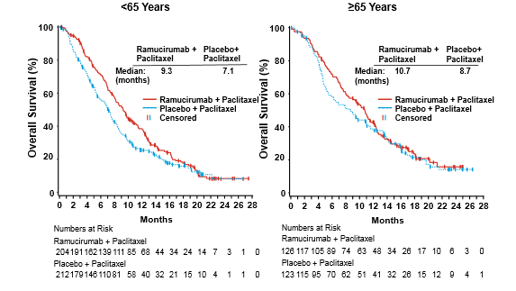
Kaplan-Meier Estimates of Overall Survival
P = .0112
P = .3394
Muro K, et al. J Clin Oncol. 2015;33 (suppl 3): Abstract 11.

Slide 10
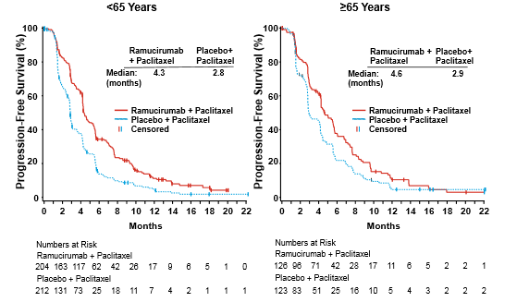
Kaplan-Meier Estimates of Progression-Free Survival
P<.0001
P = .0066
Muro K, et al. J Clin Oncol. 2015;33 (suppl 3): Abstract 11.

Slide 11
Response and Duration of Therapy
 | Age <65 Years |  | Age ≥65 Years
 | RAM (N = 204) | PBO (N = 206) | RAM (N = 123) | PBO (N = 123)
Objective response rate | 28.4 | 14.2 | 27.0 | 19.5
Duration of therapy, weeks, mean (SD) | 23.4 (18.4) | 16.2 (13.4) | 23.8 (19.1) | 18.6 (16.5)
Total # 28-day cycles received, mean (SD) | 5.7 (4.2) | 4.1 (3.2) | 5.8 (4.5) | 4.6 (3.9)
Muro K, et al. J Clin Oncol. 2015;33 (suppl 3): Abstract 11.

Slide 12
Non-Hematologic Treatment-Emergent Adverse Events (≥20% of Patients)
Age <65
Age ≥65
 | RAM (N = 204) |  | PBO (N = 206) |  | RAM (N = 123) |  | PBO (N = 123)
% | Any grade | Grade ≥3 | Any Grade | Grade ≥3 | Any grade | Grade ≥3 | Any grade | Grade ≥3
Any | 99.0 | 79.4 | 97.1 | 64.1 | 99.2 | 85.4 | 99.2 | 60.2
Alopecia | 29.4 | 0 | 36.9 | 0 | 38.2 | 0 | 41.5 | 0.8
Neuropathy | 47.1 | 8.3 | 32.0 | 2.4 | 43.9 | 8.1 | 43.1 | 8.1
Decreased appetite | 37.3 | 2.5 | 29.6 | 4.4 | 44.7 | 4.1 | 35.8 | 3.3
Fatigue | 54.9 | 9.8 | 42.2 | 5.3 | 60.2 | 15.4 | 46.3 | 5.7
Diarrhea | 34.8 | 3.9 | 20.9 | 1.5 | 28.5 | 3.3 | 26.8 | 1.6
Epistaxis | 30.4 | 0.0 | 5.8 | 0.0 | 30.0 | 0.0 | 8.9 | 0.0
Stomatits | 16.7 | 1.0 | 4.9 | 0.5 | 24.4 | 0.0 | 11.4 | 0.8
Nausea | 34.8 | 1.5 | 34.0 | 2.9 | 35.8 | 2.4 | 30.9 | 1.6
Vomiting | 28.9 | 2.9 | 25.7 | 5.3 | 23.6 | 3.3 | 12.2 | 0.8
Peripheral edema | 22.5 | 2.0 | 12.1 | 0.5 | 29.3 | 0.8 | 16.3 | 0.8
Abdominal pain | 39.7 | 7.4 | 32.5 | 3.9 | 30.1 | 4.1 | 25.2 | 2.4
Pyrexia | 20.1 | 1.5 | 10.2 | 0.5 | 14.6 | 0.0 | 13.0 | 0.0
Wilke H, et al. J Clin Oncol. 2014;32(suppl 3): Abstract LBA7.
Muro K, et al. J Clin Oncol. 2015;33 (suppl 3): Abstract 11.

Slide 13
Hematologic Treatment-Emergent Adverse Events (≥10% of Patients)
Age <65
Age ≥65
 | RAM (N = 204) |  | PBO (N = 206) |  | RAM (N = 123) |  | PBO (N = 123)
% | Any grade | Grade ≥3 | Any grade | Grade ≥3 | Any grade | Grade ≥3 | Any grade | Grade ≥3
Neutropenia | 4.95 | 35.8 | 24.3 | 16.0 | 62.6 | 48.8 | 42.3 | 23.6
Febrile neutropenia | 2.0 | 2.0 | 2.9 | 2.9 | 4.9 | 4.9 | 1.6 | 1.6
Leukopenia | 31.9 | 14.7 | 17.0 | 6.3 | 37.4 | 22.0 | 27.6 | 7.3
Anemia | 30.4 | 9.3 | 36.9 | 10.7 | 39.8 | 8.9 | 33.3 | 9.8
Thrombocytopenia | 12.3 | 1.5 | 5.8 | 2.9 | 14.6 | 1.6 | 6.5 | 0.0
Wilke H, et al. J Clin Oncol. 2014;32(suppl 3): Abstract LBA7.
Muro K, et al. J Clin Oncol. 2015;33 (suppl 3): Abstract 11.

Slide 14
AEs of Special Interest
Age <65
Age ≥65
 | RAM (N = 204) |  | PBO (N = 206) |  | RAM (N = 123) |  | PBO (N = 123)
% | Any grade | Grade ≥3 | Any grade | Grade ≥3 | Any grade | Grade ≥3 | Any grade | Grade ≥3
Any | 64.7 | 24.5 | 35.9 | 10.2 | 63.4 | 26.0 | 39.8 | 11.4
Bleeding/hemorrhage | 41.2 | 3.9 | 17.5 | 3.4 | 43.1 | 4.9 | 18.7 | 0.8
Proteinuria | 18.1 | 2.0 | 5.8 | 0 | 14.6 | 0 | 6.5 | 0
Hypertension | 23.5 | 12.3 | 5.8 | 1.9 | 27.6 | 18.7 | 5.7 | 4.1
GI hemorrhage | 9.8 | 3.4 | 6.8 | 1.9 | 10.6 | 4.1 | 4.9 | 0.8
Infusion-related reaction | 6.9 | 0.5 | 3.9 | 0 | 4.1 | 0.8 | 3.3 | 0
Venous thromboembolic | 4.4 | 2.9 | 3.9 | 1.9 | 3.3 | 1.6 | 8.1 | 5.7
Cardiac failure | 1.5 | 0.5 | 1.5 | 1.0 | 4.1 | 0.8 | 0.8 | 0
Arteriothromboembolic | 2.9 | 1.5 | 1.0 | 1.0 | 0 | 0 | 2.4 | 0.8
GI perforation | 1.0 | 1.0 | 0 | 0 | 1.6 | 1.6 | 0.8 | 0
Muro K, et al. J Clin Oncol. 2015;33 (suppl 3): Abstract 11.

Slide 15
Conclusions
Patient characteristics were generally well-balanced between the treatment arms in both age groups
There were more patients with intestinal type tumors and with time progression on first-line therapy >6 months in the ≥65 year group
Ramucirumab plus paclitaxel conferred similar improvements over placebo plus paclitaxel for OS, PFS, and ORR in both age groups
Drug exposure for ramucirumab plus paclitaxel and placebo plus paclitaxel was similar in both age groups
Higher percentages of patients in the ramucirumab plus paclitaxel arm discontinued treatment due to adverse events and had dose modifications
Dose modifications of paclitaxel occurred more frequently in patients aged ≥65 years
Toxicity profiles were similar in both age groups, although a relatively higher incidence of grade ≥3 neutropenia and of grade >3 leukopenia was seen in patients aged ≥65 years
Muro K, et al. J Clin Oncol. 2015;33 (suppl 3): Abstract 11.

